Slide 1
Development of a low fidelity structural model for multifidelity aeroelastic optimization
Author:
Giovanni QUAGLIA
Supervisors:
Pr. Joseph MORLIER
PhD. Joan MAS COLOMER
27/06/2019

Slide 2
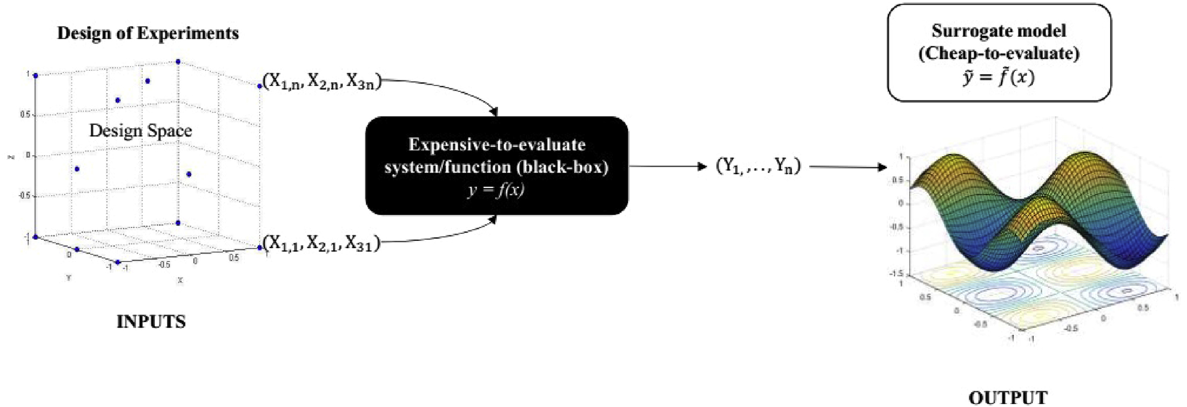
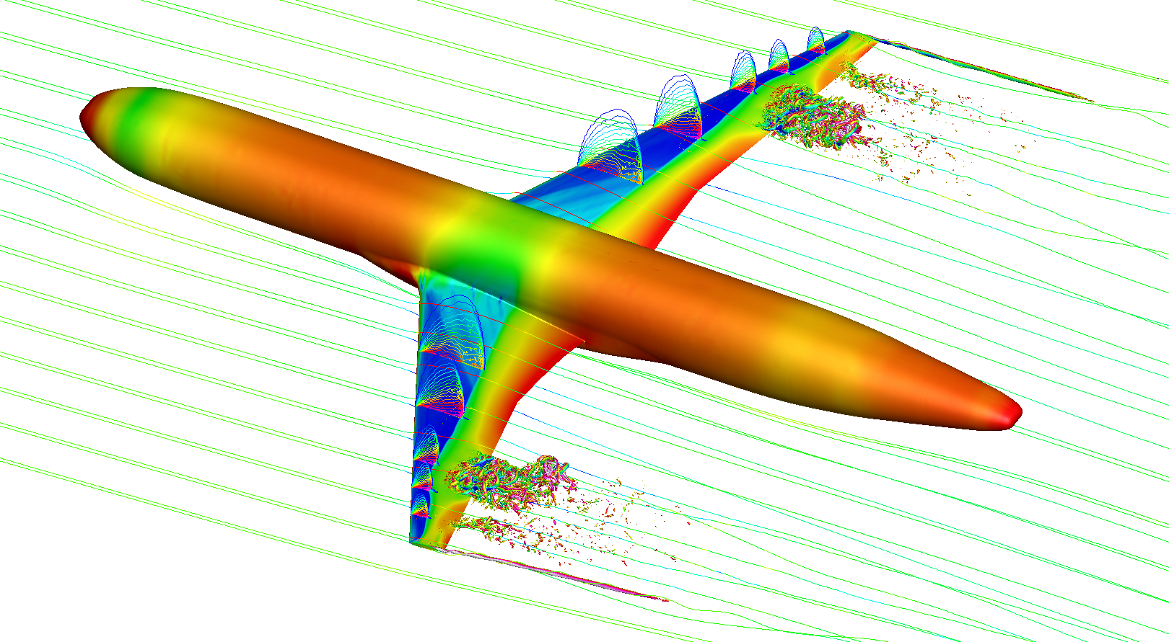
Context
The reduction of computational cost is a subject of major interest in aircraft design.
[Yondo et al, Progress in Aerospace Sciences, 2018]
COMPLEX MODEL
Solution approaches: Surrogate Models and Multifidelity.

Slide 3
Summary
State of the art
Black Box Aeroelastic Function
Multifidelity
Surrogate Models
Kriging
Co-Kriging
Optimization
Research Project
Introduction
Low fidelity structure design
The NASA CRM wing
Sorting the original nodes
Mesh redefinition
Model validation
Mesh resolution influence
Correlation analysis
Conclusion & Future steps

Slide 4
I. State of the art

Slide 5
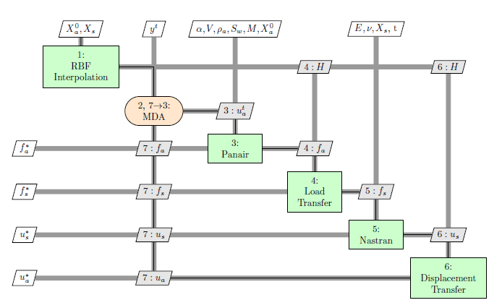
Black Box Aeroelastic Function
Fluid-Structure interaction problem is solved in an iterative partitioned approach.
Two separate aerodynamics and structural software are coupled together in a unique function.
The Quantities of Interest (QoI) are computed at convergence.
[Mas-Colomer, PhD thesis, 2018]
OpenMDAO aerostructures Model

Slide 6
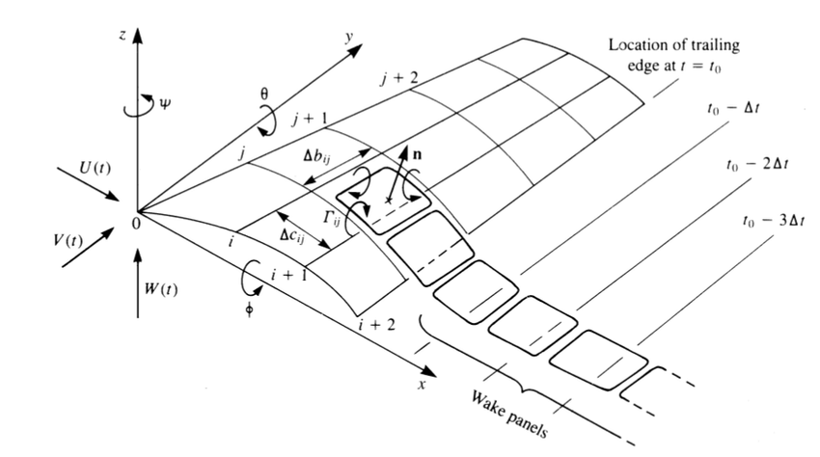
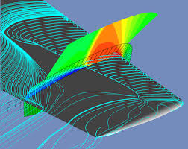
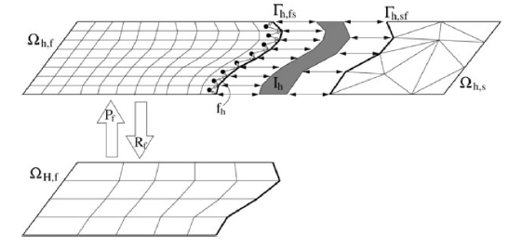
Multifidelity
The employment of functions with different accuracy and computational time can speed up the design process.
[Katz et al, Low-speed aerodynamics, 2001]
Features:
Large correlation between the models
Different computational time scales
Examples:
High and Low fidelity software (HF and LF)
Relaxed convergence criterion
Various mesh resolutions
Experiments
[Onera]
[Scholcz, PhD thesis, 2015]

Slide 7
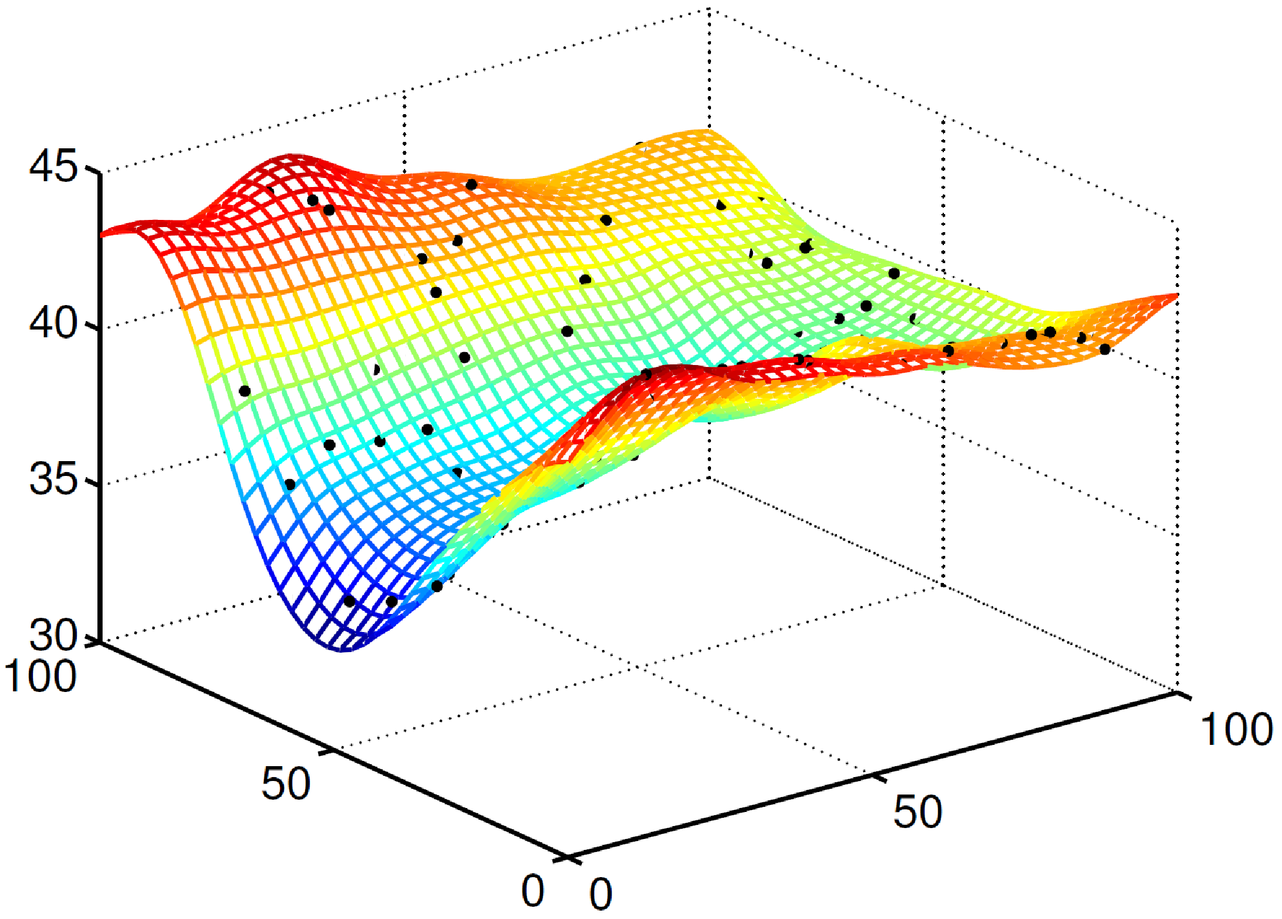
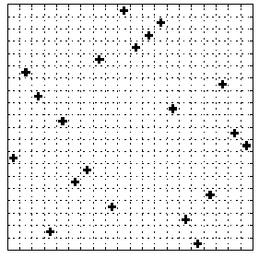
Surrogate Model
Computational cost is decreased analyzing a surrogate model of the real function.
[Forrester et al, Proceedings of the Royal Society A, 2007]
[ETH]
DOE Sampling
Ex. LHS
Interpolation
Ex. Kriging, Co-Kriging

Slide 8
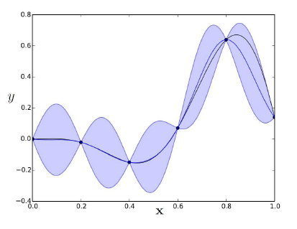
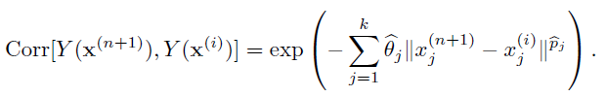
Surrogate Model
Kriging interpolation fits data to a Gaussian Process with constant mean and a defined covariance.
[Bartoli et al, 2016]
[Forrester et al, Proceedings of the Royal Society A, 2007]
Uncertainty on the prediction is zero in the sampled points and increases with distance.

Slide 9
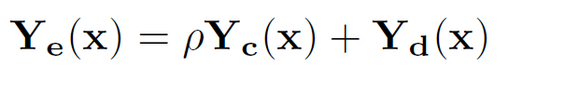
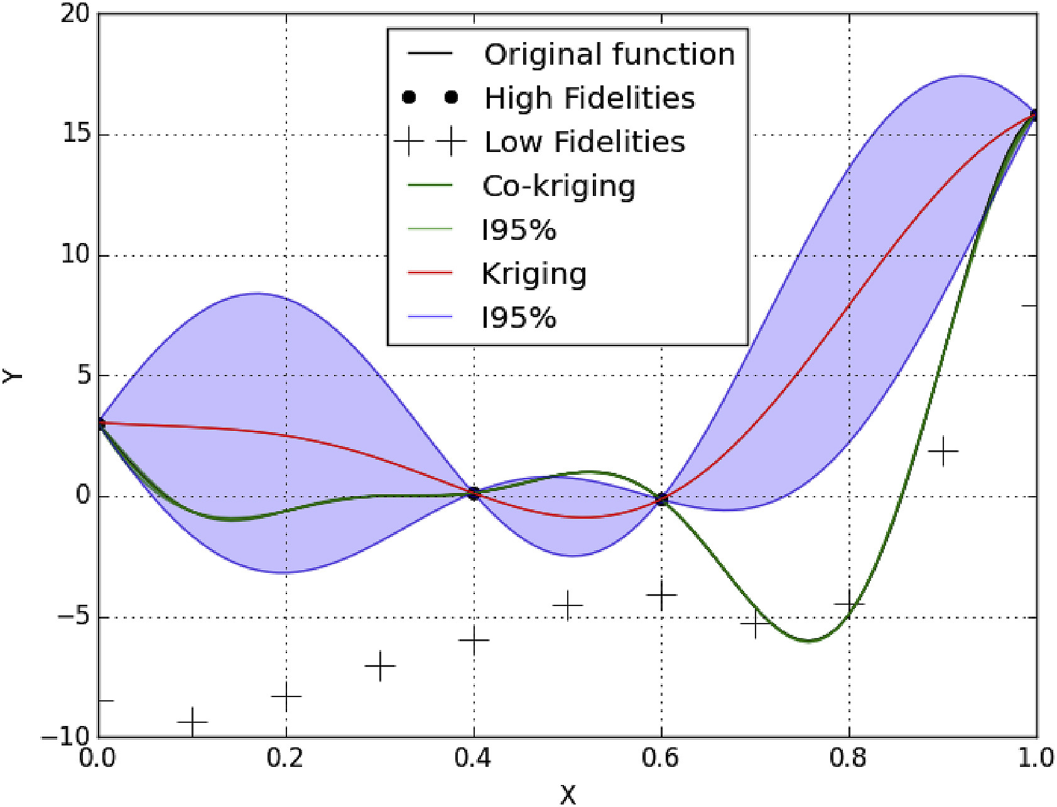
Surrogate Model
Co-Kriging interpolation takes into account data from two sources of different fidelity.
[Yondo et al, Progress in Aerospace Sciences, 2018]
[Forrester et al, Proceedings of the Royal Society A, 2007]
The prediction is based on the error between the High and Low Fidelity models.
Then a lower number of HF evaluations is required to build the surrogate model.

Slide 10
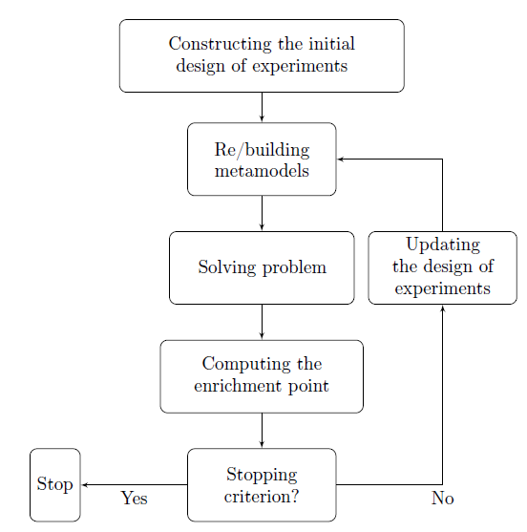
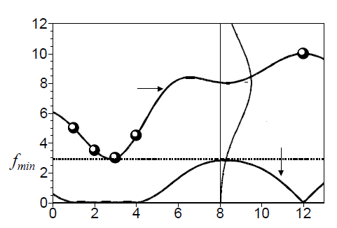
Optimization
Variable optimization can be performed on the surrogate model.
Probability
Prediction
Expected Improvement
[Jones, Journal of Global Optimization, 1998]
The optimum research balances exploration and exploitation considering the model uncertainty → Efficient Global Optimization (EGO).
[Bartoli et al, 2016]

Slide 11
Optimization
Finally:
It is possible to implement different fidelity in the optimization loop.
The surrogate model must be able to balance the information
A trade-off cost / accuracy determines how to compute the next query point.

Slide 12
II. Research Project

Slide 13
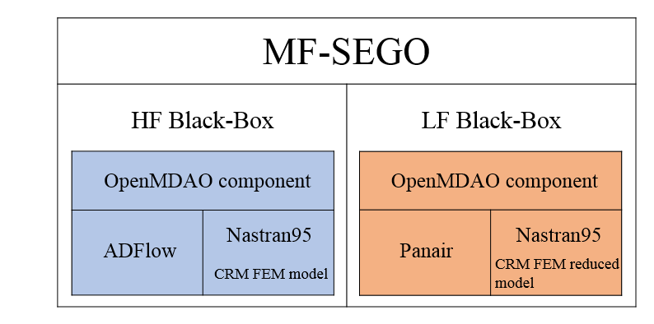
Introduction
The next objective in the research is optimizing an aircraft wing under a Multifidelity approach and using the SuperEGO algorithm.

Slide 14
Introduction
Problem: the structural model for the FEM analysis has still the same complexity in the HF and LF functions.

Slide 15
Introduction
Project planning:
Decrease in the original structure mesh resolution producing a new low fidelity representation. (MATLAB environment).
Validation of the correlation between models. (OpenMDAO environment).

Slide 16
Low fidelity structure design

Slide 17
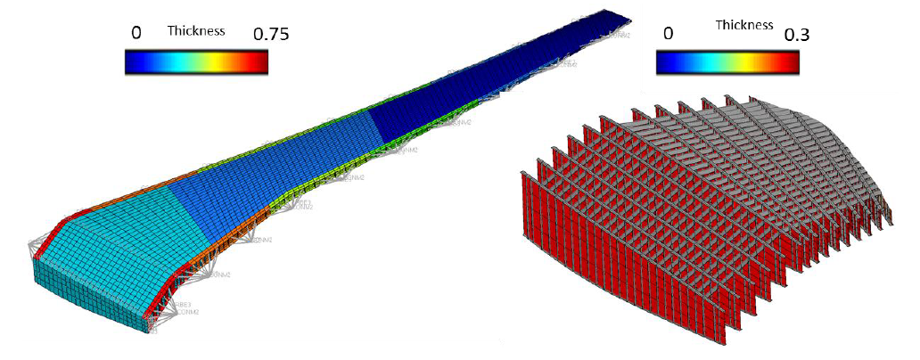
CRM Structural model
The framework is currently tested on the NASA Common Research Model wing.
[NASA CRM]
It contains ~10k nodes and ~26k elements.

Slide 18
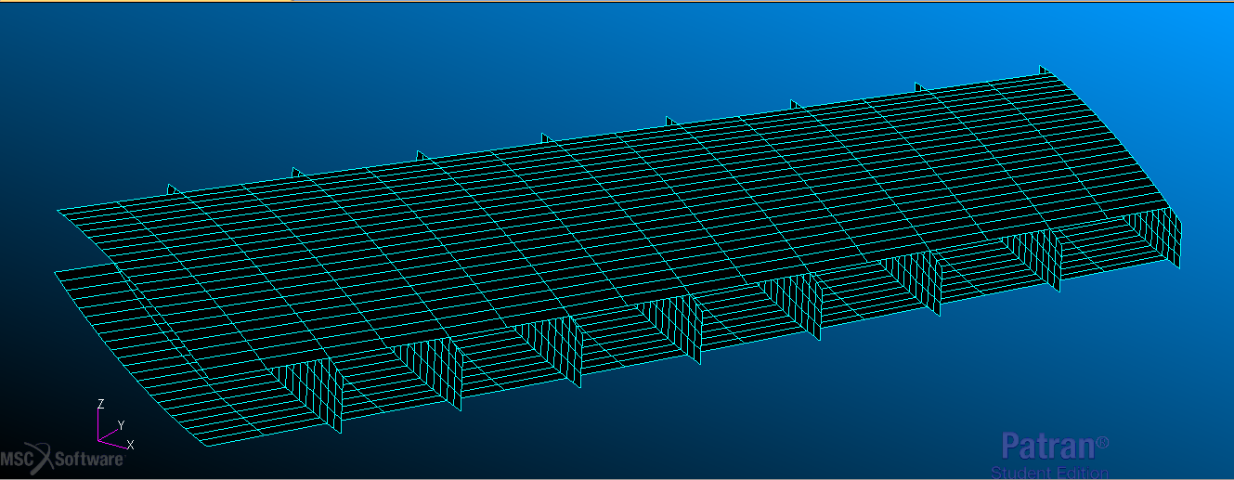
CRM Structural Model
The model includes:
Ribs, upper and lower skin.

Slide 19
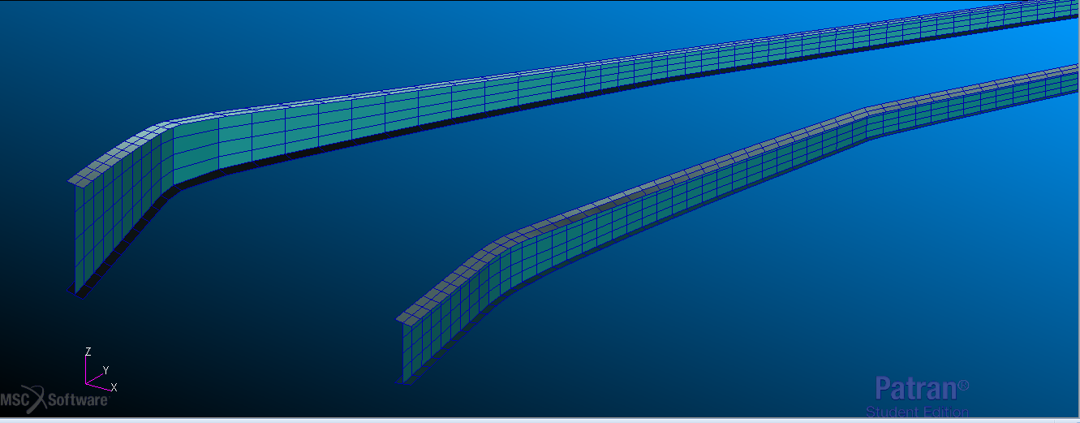
CRM Structural Model
The model includes:
Spars.

Slide 20
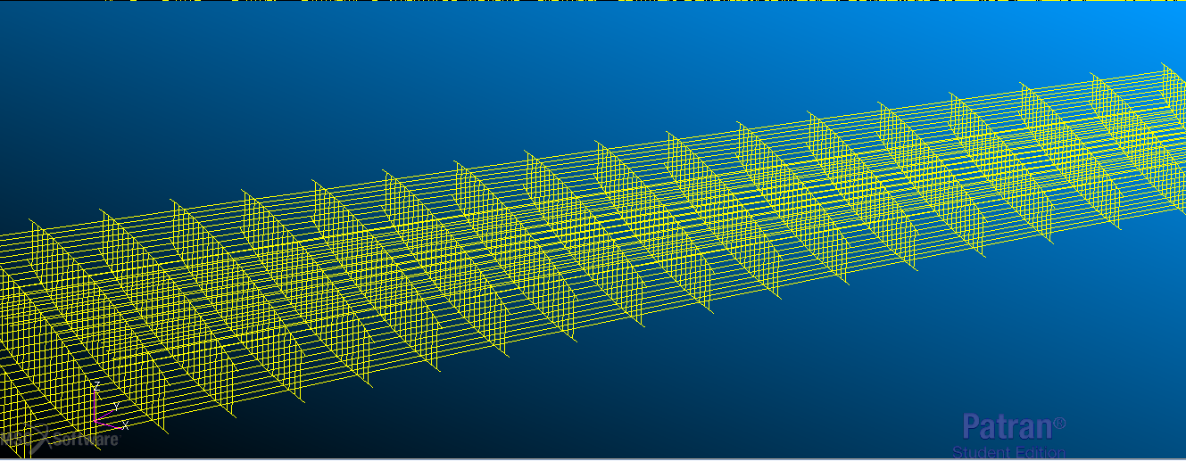
CRM Structural Model
The model includes:
Stringers and stiffeners.

Slide 21
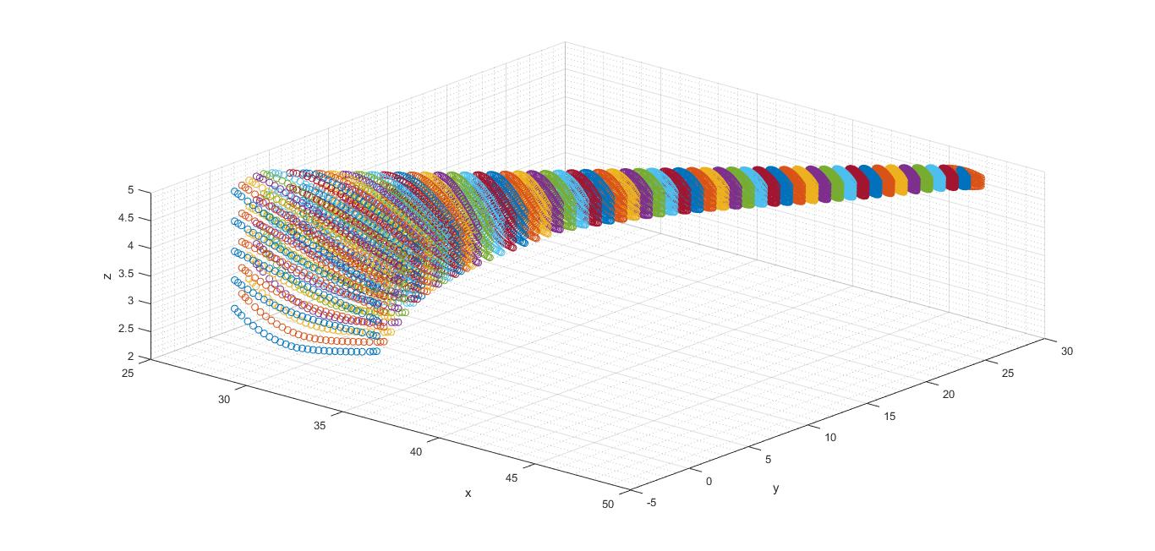
Sorting the original nodes
Nodes and elements of the NASA .bdf file where in random order.
One first MATLAB tool was coded to sort and reindex them by section.

Slide 22
Mesh redefinition
The L and V parameters are a user choice to set the number of nodes in the LF model along the rib plane axes.

Slide 23
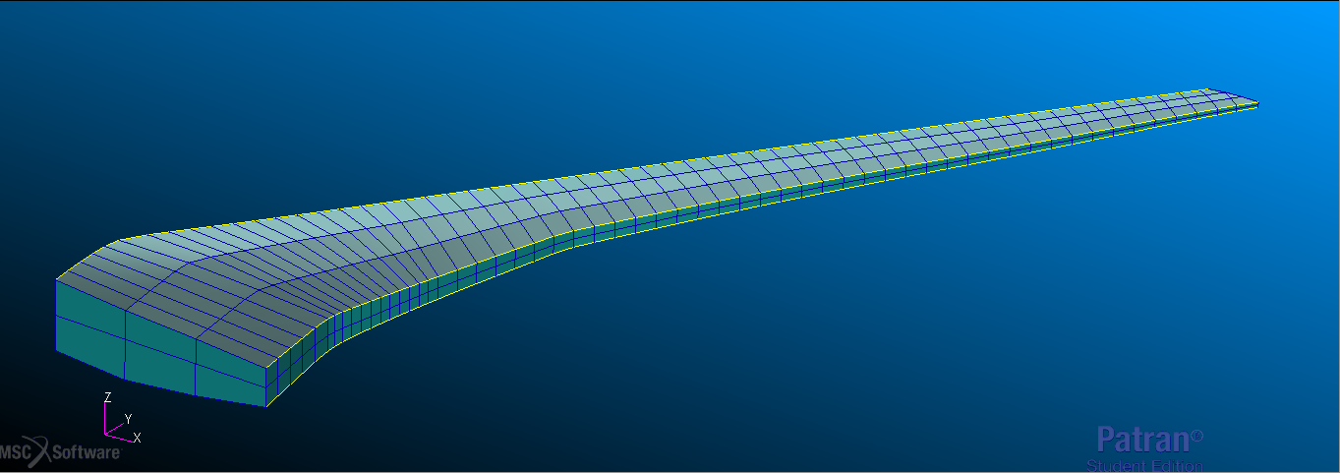
Low fidelity structural model
A second MATLAB tool creates the new reduced element list.
Param. case:
L = 4.
V = 3.
Nodes: 690.
Elements: 2168.
Simplified assumptions are made on the tip structure and on the spar modelling.

Slide 24
Model validation

Slide 25
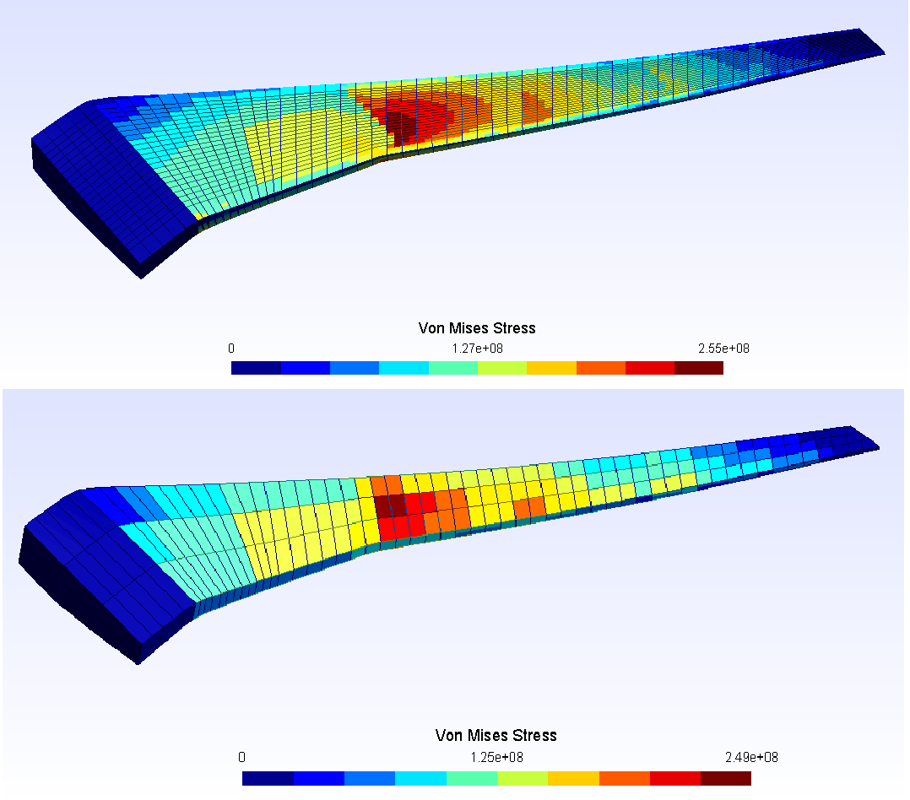
Mesh resolution influence
The OpenMDAO aerostructures framework permits to solve a static aeroelastic problem for a wing in cruise condition, using both the HF and LF FEM models.
The package is modified to maintain the overall structural stiffness.
Postprocessing visualization is performed with Gmsh.
The following QoI are extracted from Panair and Nastran95:
Lift coefficient
Drag coefficient
Maximum Von Mises stress
Tip vertical displacement

Slide 26
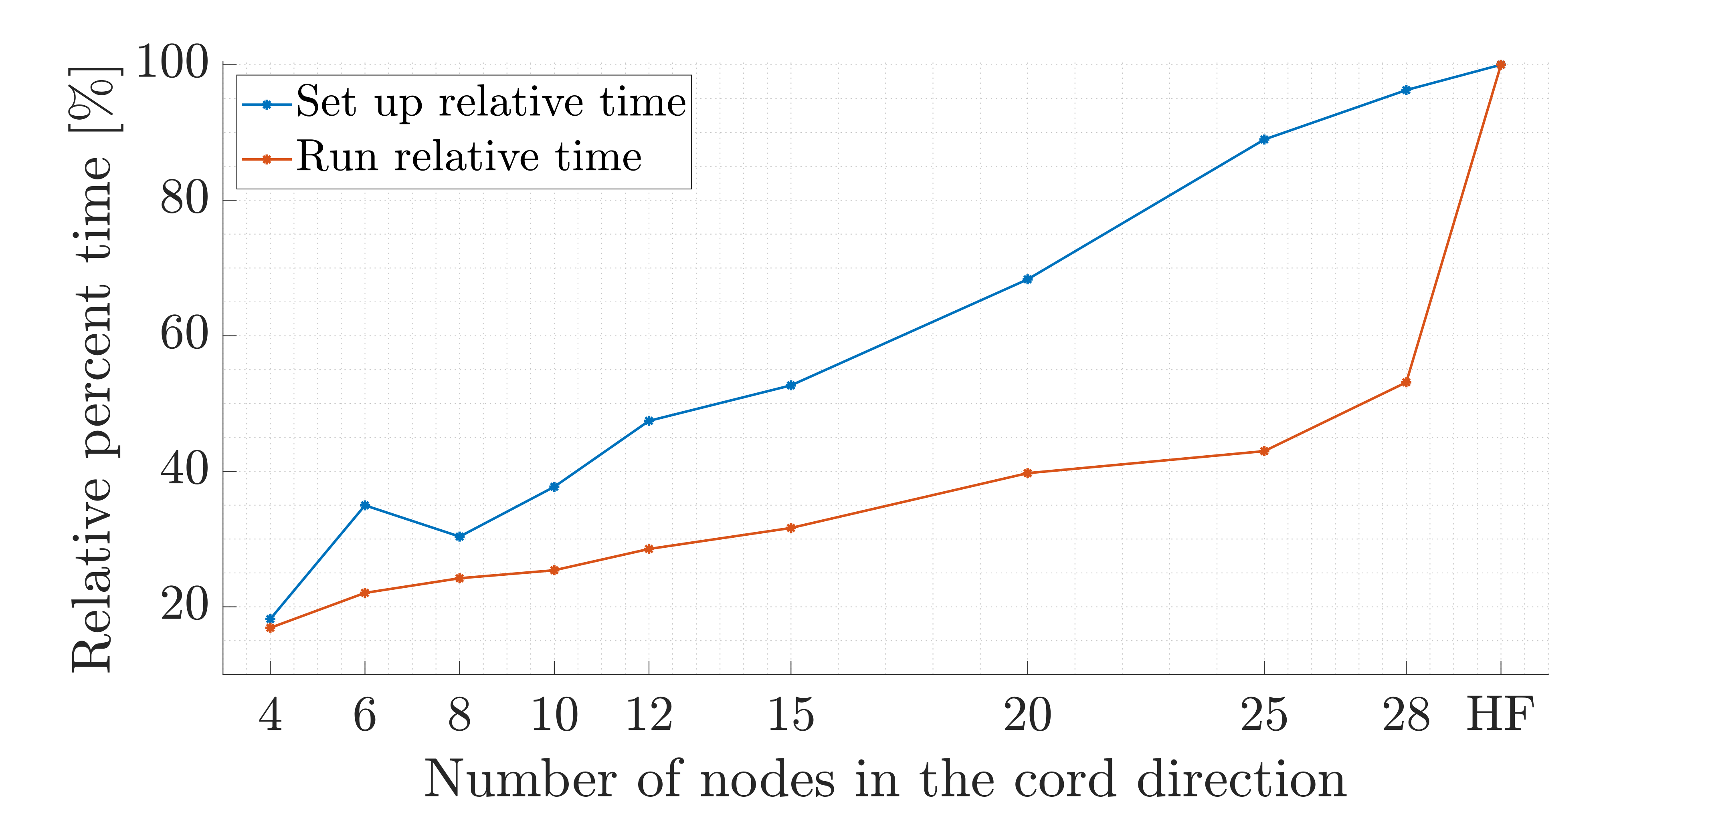
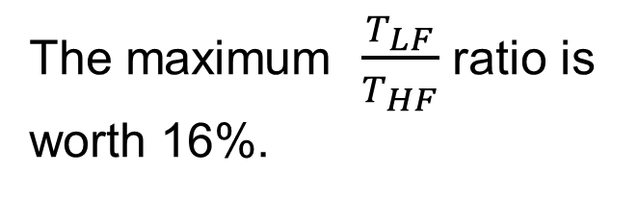
Mesh resolution influence
Different realizations of the LF models, depending on the L parameter, are compared to the HF reference.
As a first result the computational time scaling is measured.
The maximum $\frac{T_{LF}}{T_{HF}}$ ratio is worth 16%.

Slide 27
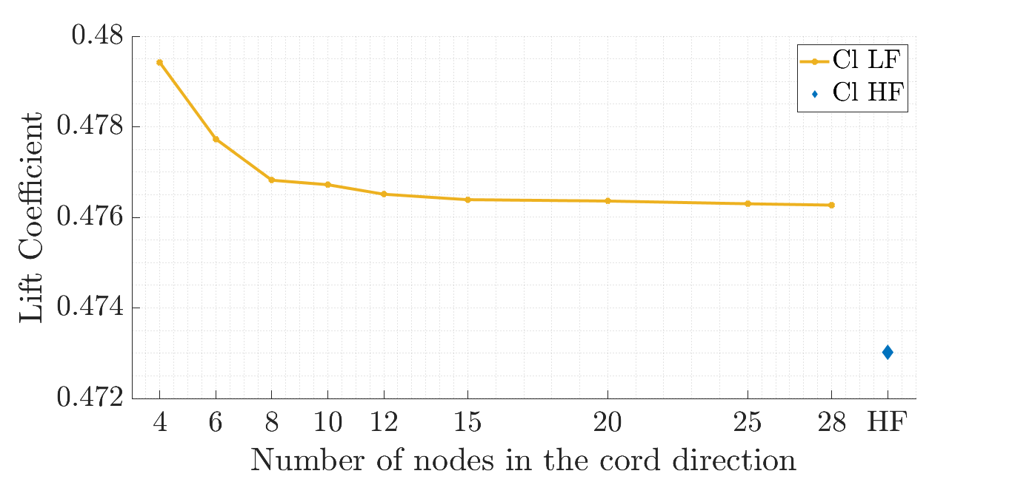
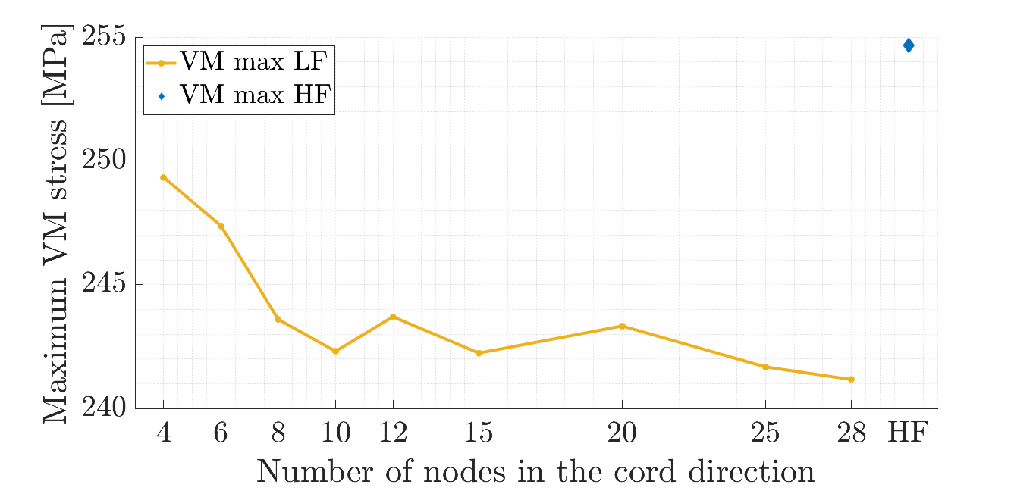
Mesh resolution influence
The QoI graphs show a convergent trend demonstrating the correct formulation of the MATLAB tool.
The offset from the reference value is due to simplified assumptions made during the design phase.

Slide 28
Correlation analysis
Since increasing the mesh resolution does not provide any fidelity improvements, the model adopted has L = 4.
Two design variable cases are considered for the model correlation validation.
Pearson correlation coefficient (PCC), maximum and minimum percent offsets are the computed outputs.

Slide 29
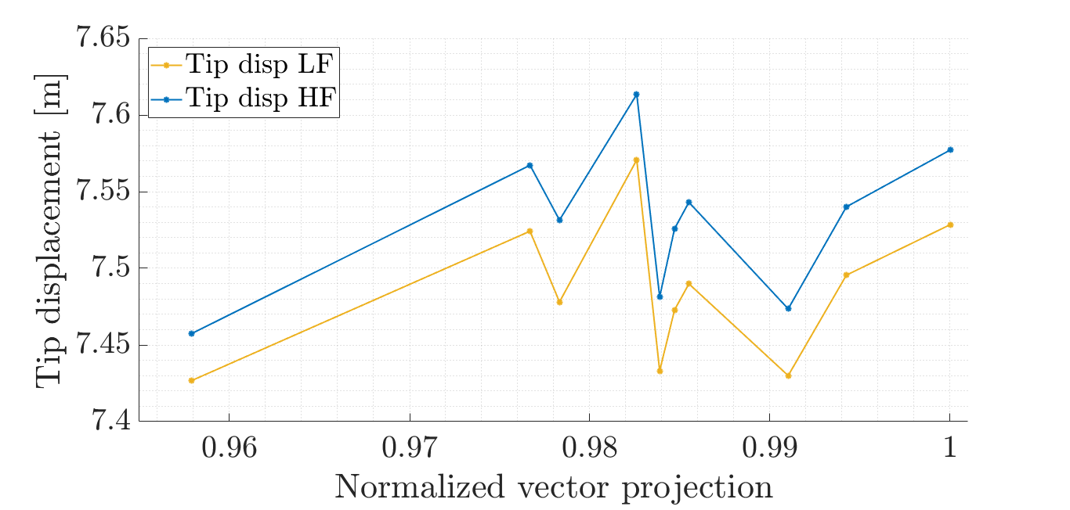
Correlation analysis
Case 1: Random variation of the panel thicknesses.
QoI comparison:
 | CL | CDi | Tip disp. | Max VM
PCC | 0.9995 | 0.9987 | 0.9903 | 0.9849
Δmax. | 1.365% | 1.693% | 0.704% | 3.477%
Δmin. | 1.126% | 0.790% | 0.404% | 0.219%

Slide 30
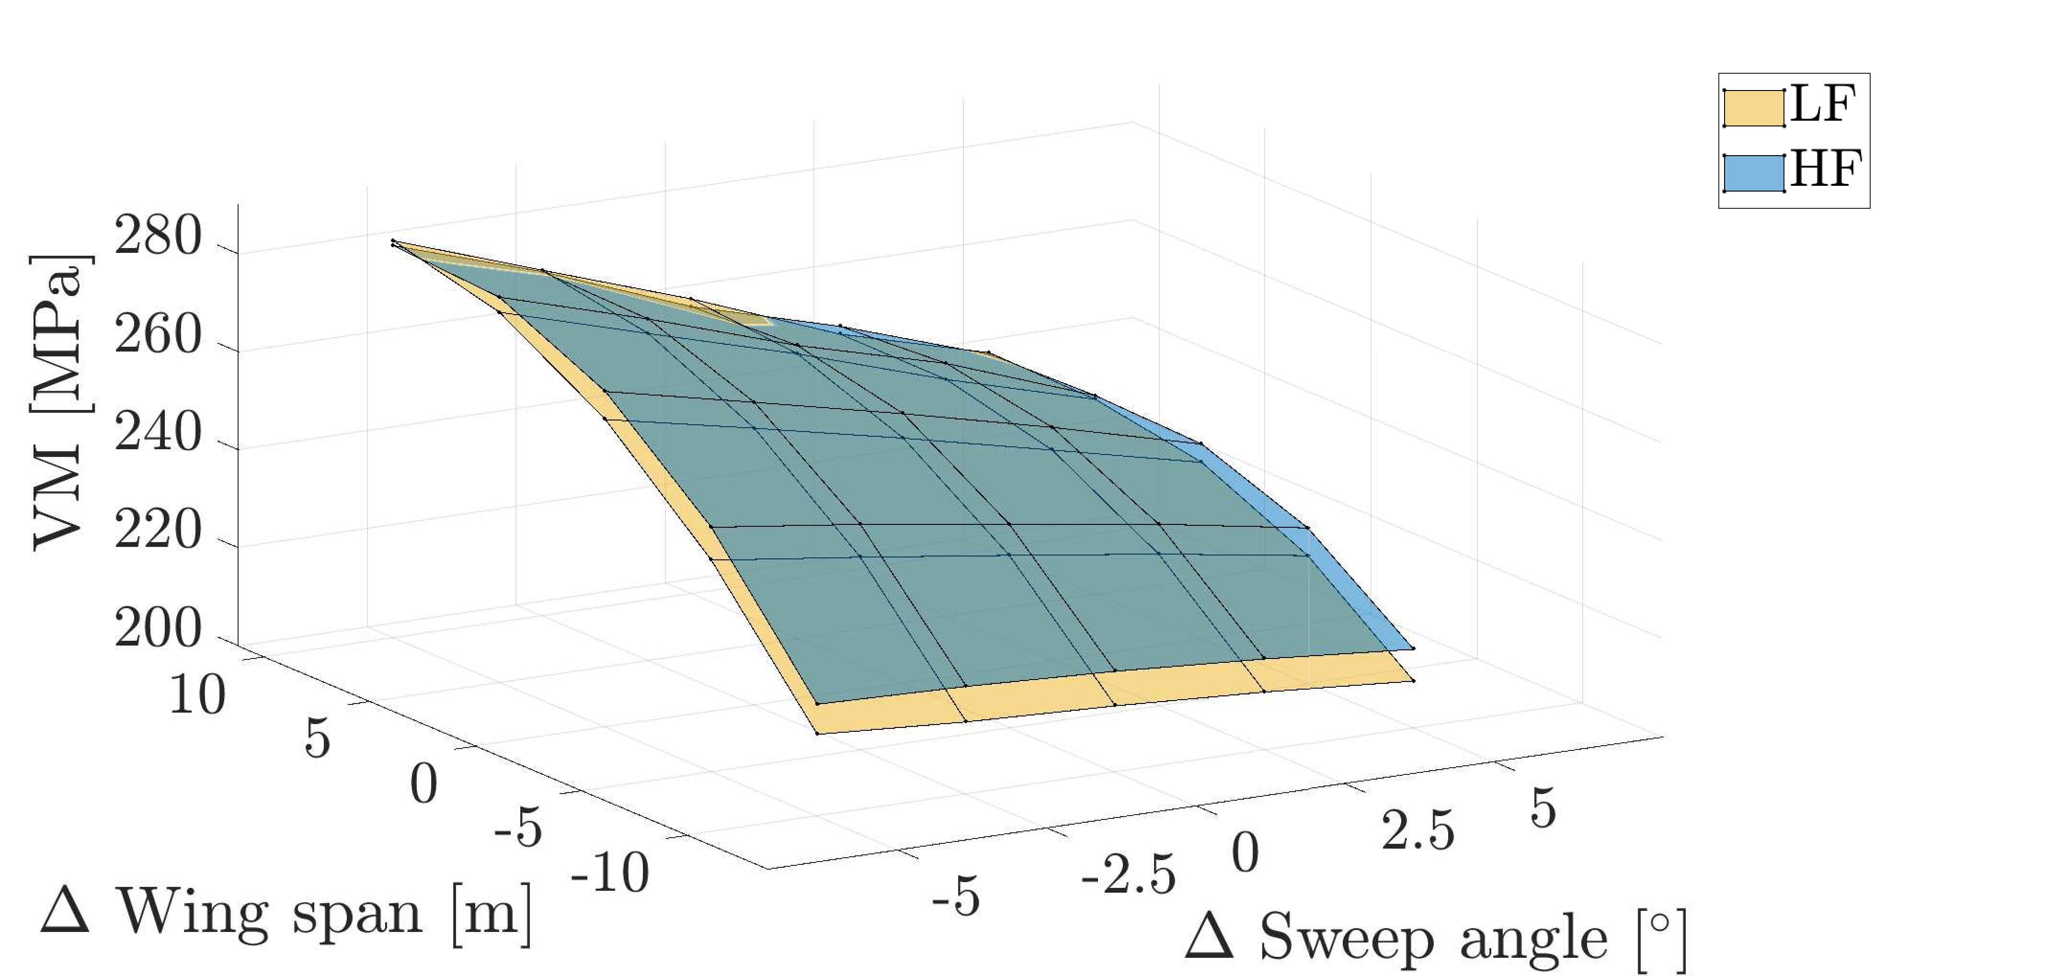
Correlation analysis
Case 2: Variation of wing span and sweep angle values by defined intervals.
QoI comparison:
 | CL | CDi | Tip disp. | Max VM
PCC | 0.9998 | 0.9982 | 0.9997 | 0.9945
Δmax. | 1.694% | 1.547% | 0.884% | 2.841%
Δmin. | 0.354% | 0. 119% | 0.015% | 0.118%

Slide 31
Conclusions
Main results:
The desired low fidelity structural model has been designed
The MATLAB implementation can be exploited for further simplification of the model
The correlation properties have been tested in 2 different cases showing perfect accordance

Slide 32
Future steps
Updated project planning:
Decrease of the original structure mesh resolution producing a new low fidelity representation. (MATLAB environment)
Validation of the correlation between the models. (OpenMDAO environment)
Dynamic comparison of the HF and LF models for modal similarity
Introduction of the LF structure in the optimization algorithm and analysis of the MF improvements

Slide 33
Thanks for your attention!
Any questions?

Slide 34
References
[Bartoli et al., 2016] Bartoli, N., Kurek, I., Lafage, R., Lefebvre, T., Priem, R., Bouhlel, M. A.,
Morlier, J., Stilz, V., and Regis, R. (2016). Improvement of efficient global optimization with mixture of experts: methodology developments and preliminary results in aircraft wing design.
[Mas-Colomer, 2018] Mas-Colomer, J. (2018). Aeroelastic Similarity of a Flight Demonstrator via
Multidisciplinary Optimization. PhD thesis.
[Jones et al., 1998] Jones, D. R., Schonlau, M., and Welch, W. J. (1998). Efficient global optimization
of expensive black-box functions. Journal of Global Optimization, 13(4):455–492.
[Scholcz, 2015] Scholcz, T. (2015). Multi-fidelity methods for fluid-structure interaction and uncertainty
quantification.
[Jones, 2001] Jones, D. R. (2001). A taxonomy of global optimization methods based on response
surfaces. Journal of Global Optimization, 21(4):345–383.
[Forrester et al., 2007] Forrester, A. I., Sóbester, A., and Keane, A. J. (2007). Multi-fidelity optimization
via surrogate modelling. Proceedings of the Royal Society A: Mathematical, Physical and Engineering Sciences, 463(2088):3251–3269.

Slide 35
References
[Yondo et al., 2018] Yondo, R., Andrés, E., and Valero, E. (2018). A review on design of experiments and surrogate models in aircraft real-time and many-query aerodynamic analyses. Progress in Aerospace Sciences, 96:23 – 61.
[ONERA] ONERA-M6 Wing, Star of CFD. https://www.onera.fr/en/news/onera-m6-wing-star-of-cfd. Accessed: 2019-05-11.
[Katz et al., 2001] Joseph Katz and Allen Plotkin. Low-speed aerodynamics, volume 13. Cambridge university press, 2001.
[ETH] Polynomial-Chaos-Kriging. http://www.sudret.ibk.ethz.ch/research/past-projects/polynomial-chaos-kriging.html. Accessed: 2019-05-11.
[NASA CRM] NASA Common Research Model, https://commonresearchmodel.larc.nasa.gov/files/2014/02/CRM_wingboxFEM_description_1.pdf, Accessed: 21/05/2019.

